Slide 1

Ivan Jasper Evangelista
John Matthew Fonacier
Marco Theo Butalid
Luis Gino Mabaquiao

Slide 2
ABSTRACT
Asia Pacific College (APC) is manually operating its air conditioners, lights, and computers in each of the room.
Reservation is done through the receptionist who is stationed on the 4th floor
Roamers under the Security Department. (Sky One and Sky Two)
Responsible for checking rooms throughout the building
Responsible for checking the attendance of the professors during different time periods

Slide 3
INTRODUCTION
Current standard operating procedures with room reservations.
It’s manual
Time consuming
It could potentially cost the company unnecessary expenses

Slide 4
OBJECTIVE
The project is intended to help reduce the electricity consumption of APC by eliminating inefficient processes done by the Security Department through the implementation of an IoT solution.
The intention is to make the most out of the facilities used for class provided by the school for its students and employees. Maximizing satisfaction for the students and employees, at the same time, minimizing the cost for the institution. This research can be a contributory factor not only for APC, but also to other institutions of the same nature, as reducing the cost of electricity will be of help to any institution. According to Sir. Jojo Castillo, the Security Department is not really intended to operate the facilities of APC. Before, there were delegated personnel to accomplish such tasks, then it was transferred to the janitors. Since they kept losing the keys of the doors, it was transferred to the Security Department. That is now playing a huge role in reducing APC's electricity consumption.

Slide 5
General Objective
• Implement an IoT solution that will control the facilities in a room with class schedules, helping in lessening the overall electricity consumption of APC
• Improve the process involve in replacing defective facilities

Slide 6
Specific Objective
• Implement an IoT solution to automatically operate the room’s lights, air condition and/or computers that is based on the deployment of class schedules by the registrar’s office to help reduce the electricity consumption used for such operation
• Implementation of a web-based reporting system – reported by the professors, to hasten the process of replacing defective facilities

Slide 7
Related Literature
Meeting Room Monitoring
Monitoring rooms through use of sensors
Konica Minolta Laboratory Europe (KMLE) Solution
Smart Room Booking(SRB) system
Smart Meeting Rooms
identifies room availability in real-time by using motion detection and detecting light intensity in the room
Conference Room Truth Serum
This system can know if a meeting room is occupied or not regardless of the online schedule shown

Slide 8
Related Literature
Meeting Room Monitoring
Monitoring rooms through use of sensors
Konica Minolta Laboratory Europe (KMLE) Solution
Smart Room Booking(SRB) system
Smart Meeting Rooms
identifies room availability in real-time by using motion detection and detecting light intensity in the room
Conference Room Truth Serum
This system can know if a meeting room is occupied or not regardless of the online schedule shown

Slide 9
Related Literature
Meeting Room Booking System (MRBS)
can output the current and upcoming conference room bookings in real time where it is shown on the door of a conference room
Open Source Hassle-Free Booking System for Schools
online booking system where bookings are made by one person for one room at a one-time period
eliminates double booking
One Space
helps employees find available rooms for the employee’s use and work

Slide 10
Synthesis
ROOM RESERVATION SYSTEMS | AUTOMATED RESERVATION | MANUAL RESERVATION | PREVENTS BOOKING CONFLICTS | DISPLAYS CURRENT STATUS OF ROOM | DETECTS ROOM OCCUPENCY | IOT BASED | PROVIDES ANALYSIS REPORT
Meeting Room Monitoring | ✓ | ✕ | ✓ | ✓ | ✓ | ✓ | ✓
KMLE Solution | ✓ | ✕ | ✓ | ✓ | ✓ | ✓ | ✓
Smart Meeting Rooms - Intel IoT | ✓ | ✓ | ✓ | ✓ | ✓ | ✓ | ✕
Conference Room Truth Serum | ✓ | ✕ | ✓ | ✓ | ✓ | ✓ | ✕
Meeting Room Booking System (MRBS) | ✓ | ✕ | ✓ | ✓ | ✕ | ✓ | ✕
Open Source Hassle-free Room Booking System for Schools | ✓ | ✕ | ✓ | ✓ | ✕ | ✕ | ✓
One Space | ✓ | ✓ | ✓ | ✓ | ✕ | ✕ | ✓
Proposed system | ✓ | ✓ | ✓ | ✓ | ✕ | ✓ | ✓

Slide 11
Event Table

Slide 12
AGENDA

Slide 13
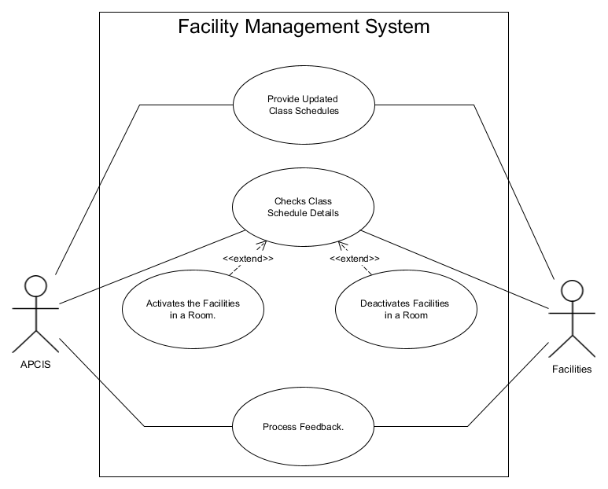
Use Case Diagram

Slide 14
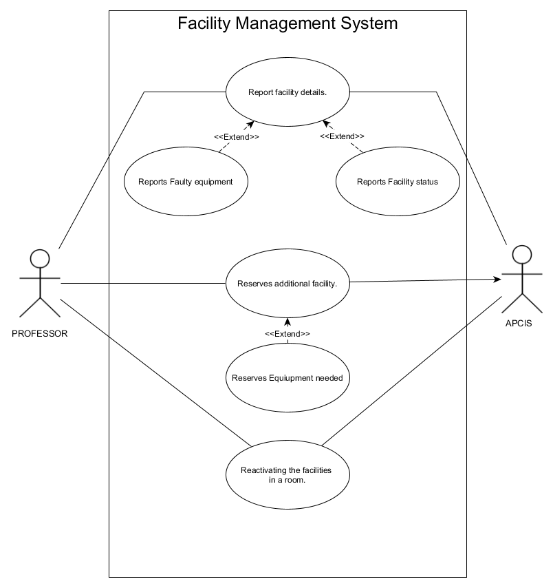
Use Case Professor

Slide 15
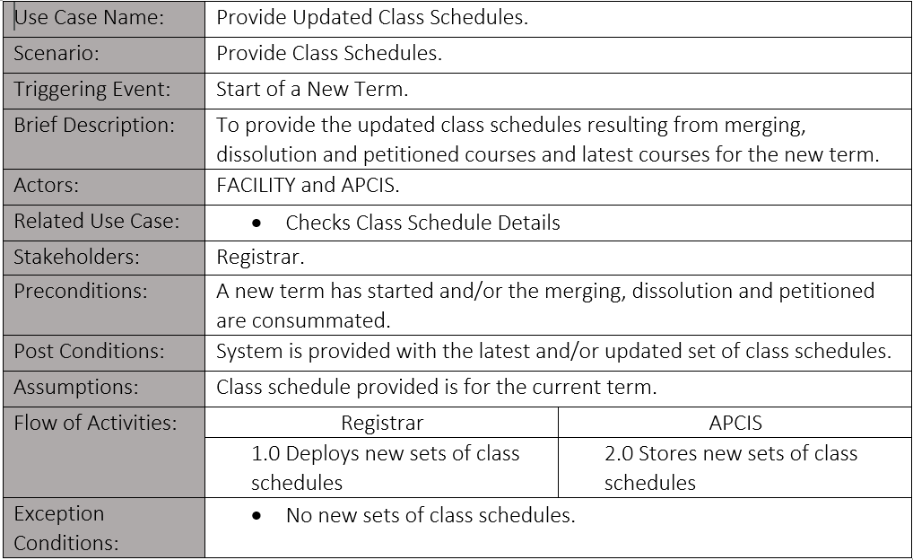
Use Case Full Description

Slide 16
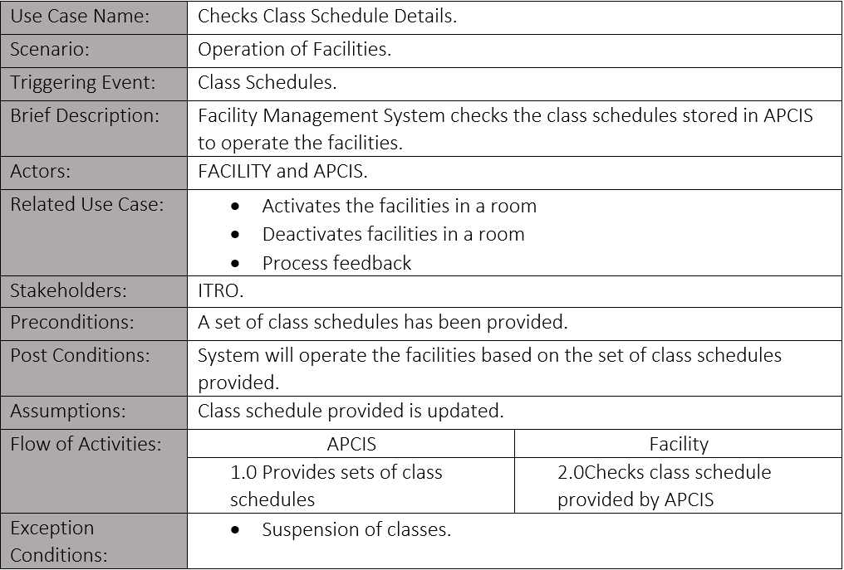
Use Case Full Description

Slide 17
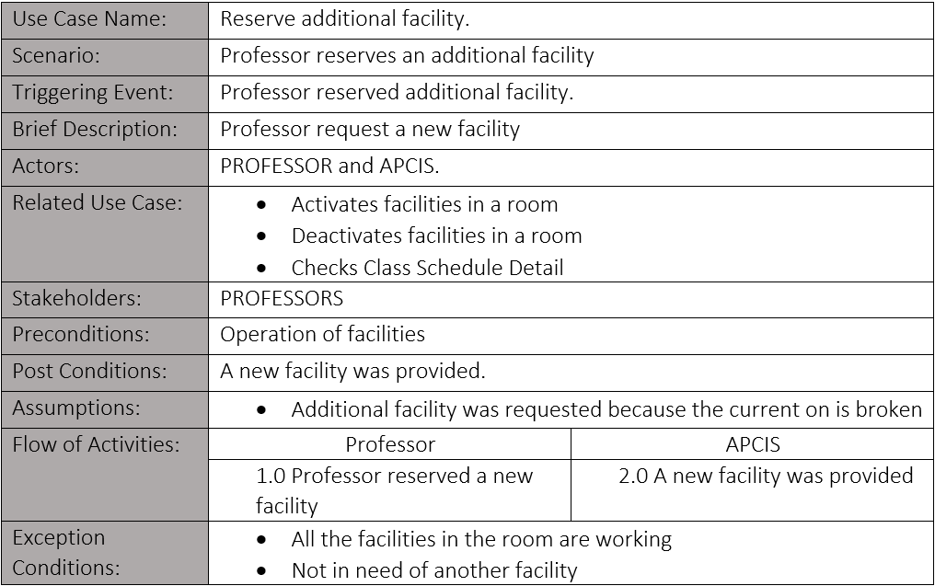
Use Case Full Description

Slide 18
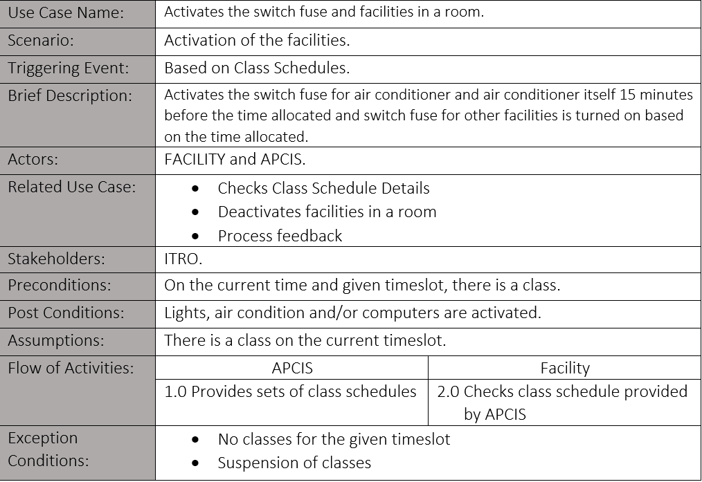
Use Case Full Description

Slide 19
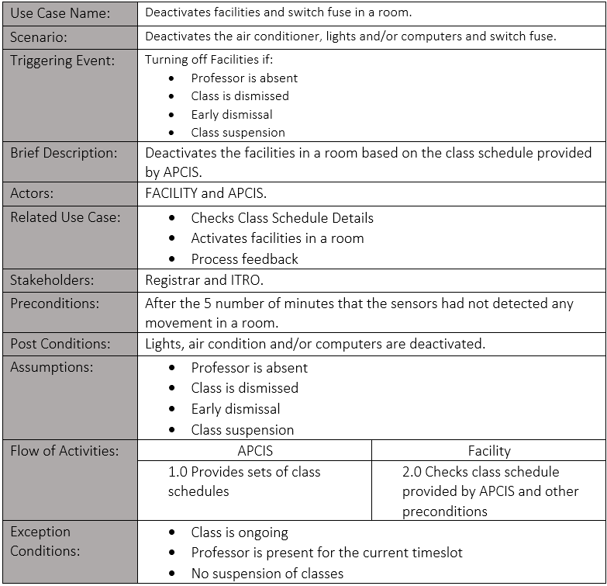
Use Case Full Description

Slide 20
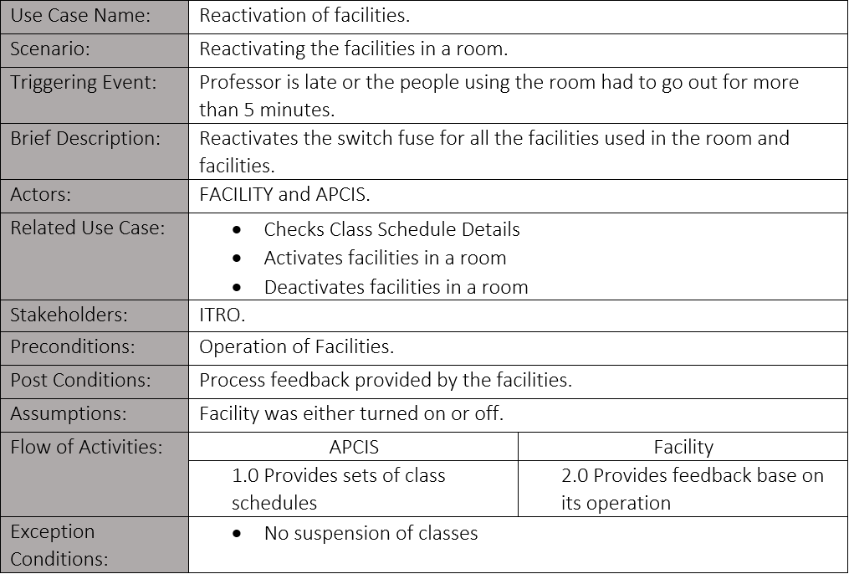
Use Case Full Description

Slide 21
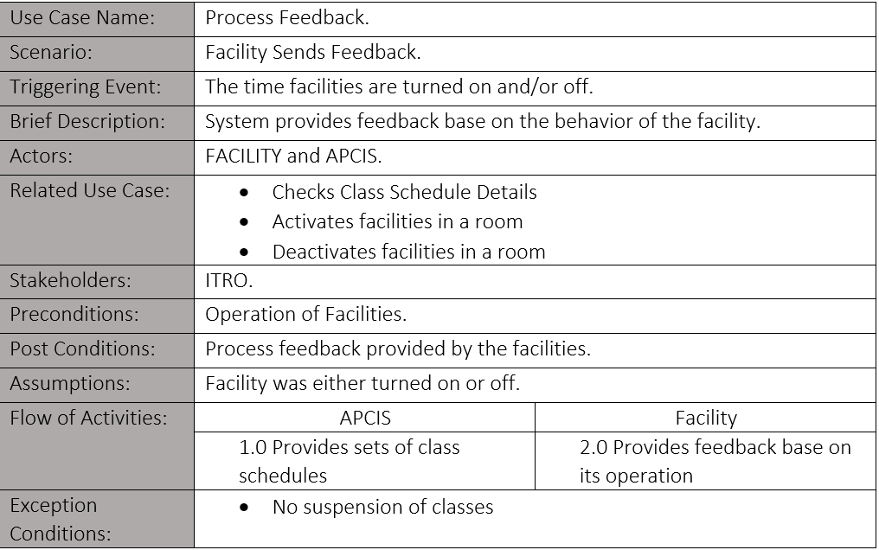
Use Case Full Description

Slide 22
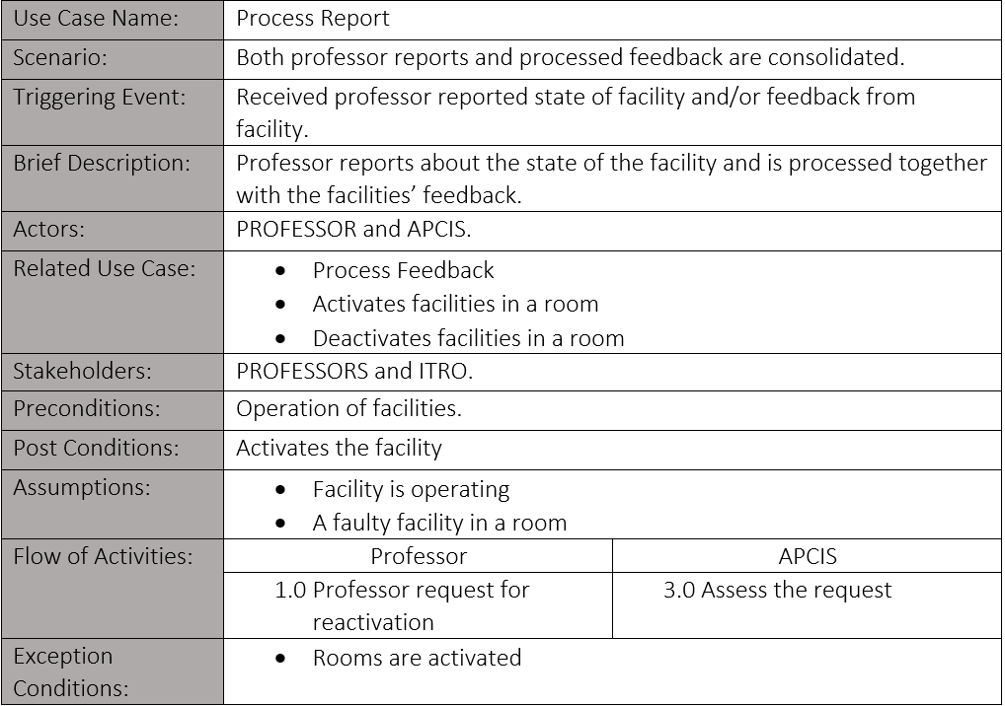
Use Case Full Description

Slide 23
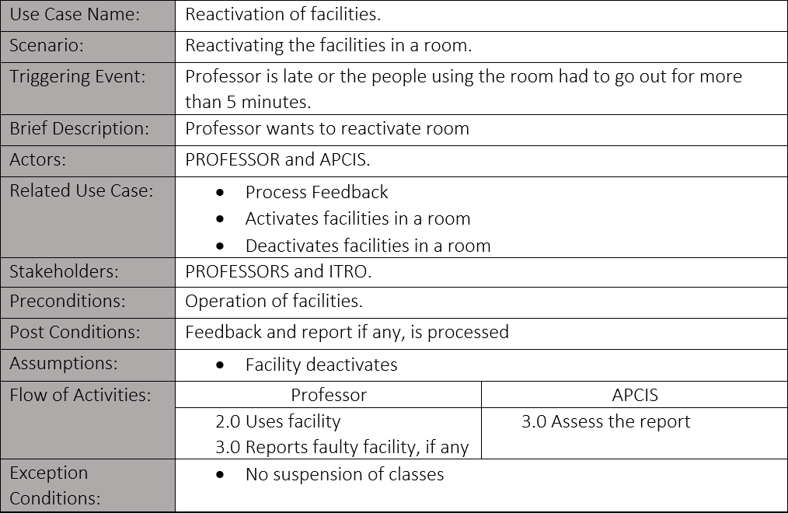
Use Case Full Description

Slide 24
Gap Analysis
Strategic Objective | Current Standing | Deficiency | Action Plan
The facilities are turned on minutes before the class or event starts. | Sky One or Sky Two turns on and the facilities manually based on class schedules and reservations that most of the time delayed. | Hindering the students to utilize the time provided by the course. | Implementation of an IoT device that is placed on fused and on the IR receiver of the air conditioner to turn on such without any manpower.
The facilities are turned off in the event: That there is no class Early dismissal Professor is not present Suspension of classes | Sky One or Sky Two turns off the facilities manually that is most of the time inaccurate. | Failure to turn off facilities on time. Underutilized usage of facilities resulting to increase in utilities and depreciation expense. | The receptionist addresses to Sky One or Sky Two that there is no class, an early dismissal, or the professor is not present.
Broken facilities are replaced or fixed as soon as possible. | Broken facilities are only replaced or fixed when noticed. | Broken facilities are usually left ignored when left unused. | Have the professor report the defective facilities to offices in charge.

Slide 25

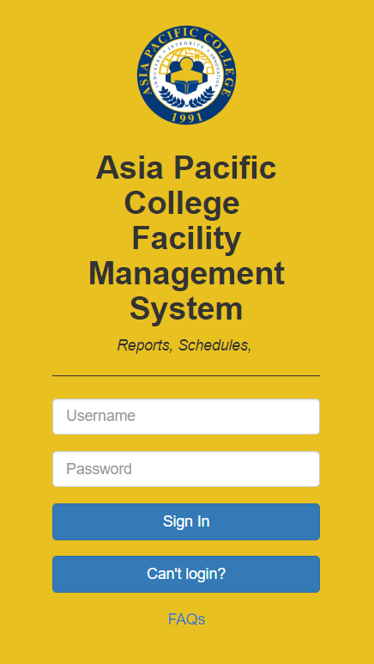

Slide 26





ADMIN
Welcome to Asia Pacific Management portal
Class Schedules
Reports
Check class schedules for the term and status
Check Facility Reports, Facility Equipment’s and Facility status

Slide 27
Professor
Welcome to Asia Pacific Management portal
Room | Section | Report | Scheduled time | Name of Professor
305 | CSIT01 | No working pc | 7:30-9:30 | Ivan Jasper Evangelista
Submit

Slide 28


Class schedules
7:43 PM
17/07/2019
Scheduled Class | Room | Time Start | Time End | Status
CSITO1 | 305 | 1:30 | 3:30 | ACTIVE
ABM121 | 608 | 7:30 | 9:30 | DEACTIVATED
MI123 | 601 | 1:30 | 5:30 | ACTIVE
GD124 | 603 | 5:30 | 7:30 | ACTIVE
ABMA128 | 605 | 3:30 | 5:30 | ACTIVE
GD334 | 608 | 11:30 | 1:30 | ACTIVE
CSITO1 | 608 | 1:30 | 3:30 | ACTIVE

Slide 29
Reports
7:43 PM
17/07/2019
Room | Section | Report | Time reported | Scheduled time | Name of Professor
305 | CSIT01 | No working pc | 7:30 | 7:30-9:30 | Ivan Jasper Evangelista
307 | CSIT01 | Closed rooms | 5:30 | 5:30-7:30 | Marco Butalid
605 | ABMA121 | Projectors | 4:30 | 4:30-5:30 | John Mattew Fonacier
607 | GD123 | Programs | 7:30 | 7:30-5:30 | Luis Gino
608 | CSIT01 | Aircon | 8:30 | 8:30-9:30 | Marco Butalid

Slide 30
DEVELOPMENT AND TESTING

Slide 31
IMPLEMENTATION PLAN(INFRASTRUCTURE/DEPLOYMENT)WHERE NEEDED

Slide 32
DESCRIPTION OF THE PROTOTYPE, WHERE APPLICABLE

Slide 33
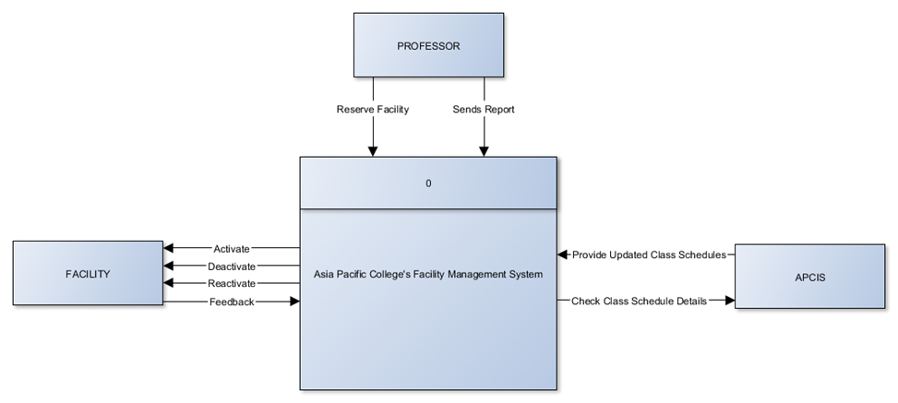
Context

Slide 34
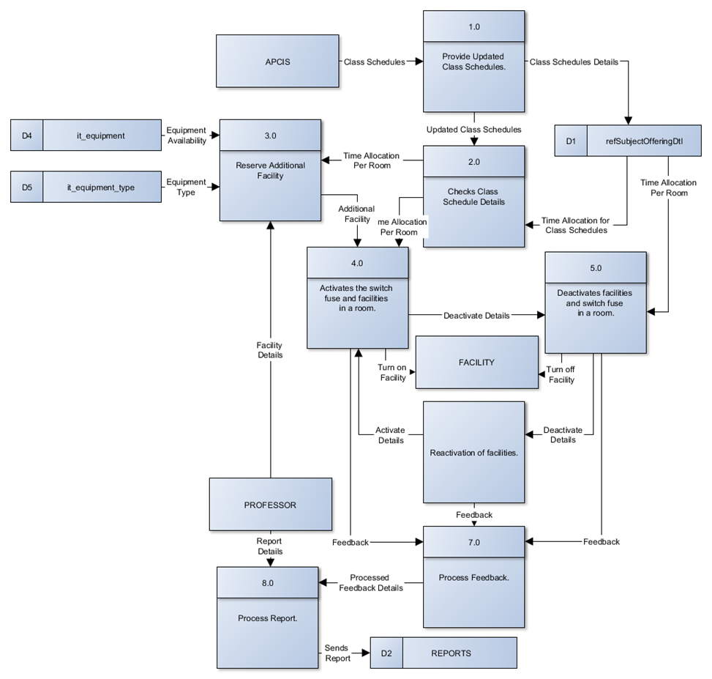
DFD LEVEL 0

Slide 35
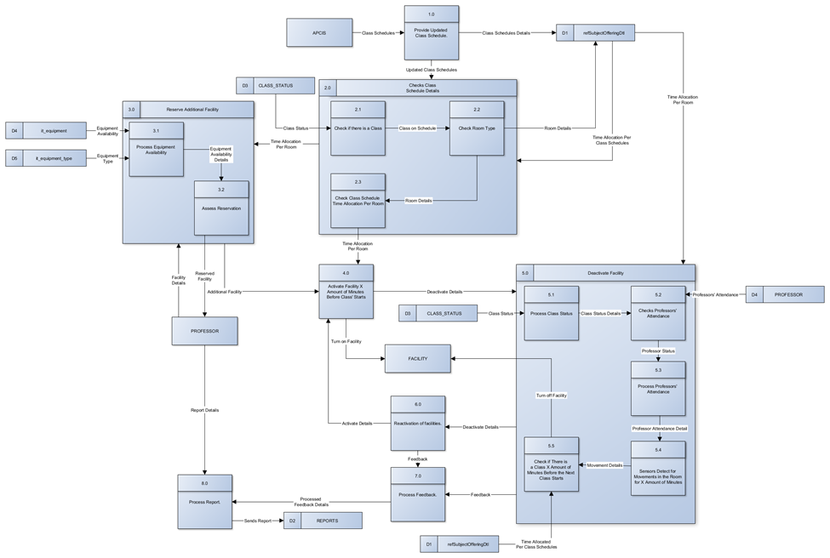
DFD LEVEL 1

Slide 36
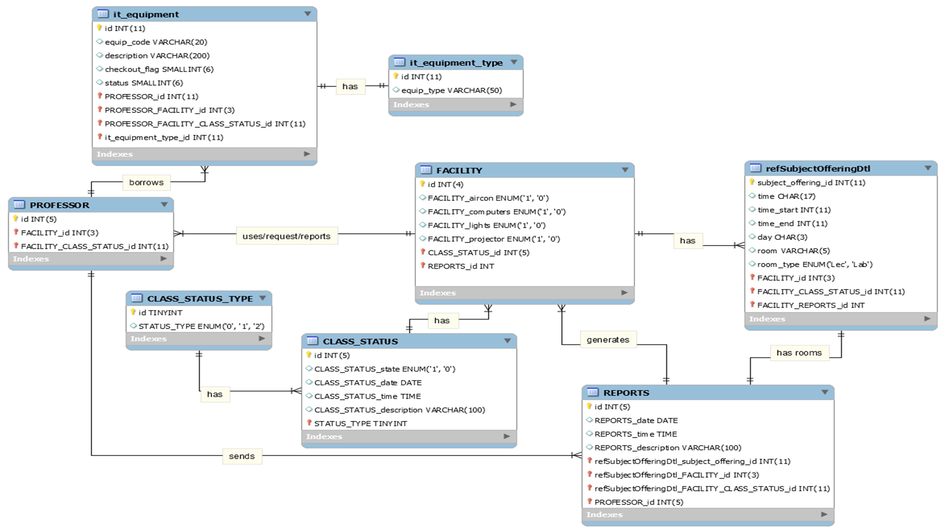
ERD

Slide 37
Data Dictionary

Slide 38
IT EQUIPMENT
Attribute Name | Contents | Type | Format | Range | Required | PK or FK | FK Referenced Table
Id | Unique identifier of it_equipment | Numeric(11) | 99999999999 | 0-99999999999 | Y | PK
equip_code | Code of equipment | VARCHAR(50) | Sample text here | 50 characters | Y
description | Remarks on reservation | TEXT | Sample text here | 65,535 characters | Y
Checkout_flag |  | SMALLINT(6) |  |  | Y
status | Status of reservation | Numeric(3) |  |  | Y
PROFESSOR_id | Unique identifier of PROFESSOR | Numeric(11) | 99999999999 | 0-99999999999 | Y | FK | PROFESSOR
PROFESSOR_ FACILITY_id | Unique identifier of PROFESSOR | Numeric(3) | 999 | 0-999 | Y | FK | PROFESSOR
PROFESSOR_ FACILITY_ CLASS_ STATUS_id | Unique identifier of PROFESSOR | Numeric(11) | 99999999999 | 0-99999999999 | Y | FK | PROFESSOR
it_equipment_ type_id | Unique identifier of it_equipment_ Type | Numeric(11) | 99999999999 | 0-99999999999 | Y | FK | It_equipment_ type

Slide 39
IT EQUIPMENT TYPE
Attribute Name | Contents | Type | Format | Range | Required | PK or FK | FK Referenced Table
Id | Unique identifier of it_equipment_ type | Numeric(1) | 99999999999 | 0-99999999999 | Y | PK
equip_type | Type of equipment | VARCHAR(50) | Sample text here. | 50 Characters | Y

Slide 40
PROFESSORS
Attribute Name | Contents | Type | Format | Range | Required | PK or FK | FK Referenced Table
Id | Unique identifier of PROFESSOR. | NUMERIC(11) | 99999999999 | 0-99999999999 | Y | PK
FACILITY_id | Unique identifier of FACILITY. | Numeric(3) | 999 | 0-999 | Y | FK | FACILITY
FACILITY_ CLASS_ STATUS_ id | Unique identifier of CLASS_ STATUS | Numeric(11) | 99999999999 | 0-99999999999 | Y | FK | FACILITY

Slide 41
refSubjectOfferingDt
Attribute Name | Contents | Type | Format | Range | Required | PK or FK | FK Referenced Table
subject_offering_id | Unique identifier of refSubjectOfferingDtl. | NUMERIC(11) | 99999999999 | 1-99999999999 | Y | PK
Time | To display the time format. | CHAR(17) | Sample text here. | 17 Characters. | N
time_start | Starting time of regular class schedule of the course. | NUMERIC(11) | 99999999999 | 1-99999999999 | Y
time_end | Ending time of regular class schedule of the course. | NUMERIC(11) | 99999999999 | 1-99999999999 | Y
Day | Day/s of the week the course takes place. | NUMERIC(11) | 99999999999 | 1-99999999999 | N
Room | Location of the room. | VARCHAR(5) | Sample text here. | 5 Characters. | Y
room_type | Type of the room, either lecture or laboratory. | ENUM | 'Lec', 'Lab' | 2 Constraints. | Y

Slide 42
FACILITY
Attribute Name | Contents | Type | Format | Range | Required | PK or FK | FK Referenced Table
id | Unique identifier of FACILITY | Numeric(4) | 9999 | 0-9999 | Y | PK
FACILITY_aircon | Turn on = 1, Turn off = 0 | ENUM | 0 or 1 | 1 Character | Y
FACILITY_computers | Turn on = 1, Turn off = 0 | ENUM | 0 or 1 | 1 Character | N
FACILITY_lights | Turn on = 1, Turn off = 0 | ENUM | 0 or 1 | 1 Character | Y
FACILITY_projector | Turn on = 1, Turn off = 0 | ENUM | 0 or 1 | 1 Character | Y
CLASS_STATUS_id | Unique indentifier of CLASS_ STATUS_ id | Numeric(5) | 99999 | 0-99999 | Y | FK | CLASS_ STATUS
REPORTS_id | Unique identifier of REPORTS | Numeric(5) | 99999 | 0-99999 | Y | FK | REPORTS

Slide 43
CLASS_STATUS
Attribute Name | Contents | Type | Format | Range | Required | PK or FK | FK Referenced Table
Id | Unique identifier of CLASS_STATUS | Numeric(5) | 99999 | 0-99999 | Y | PK
CLASS_ STATUS_date | Date of class status. | DATE | ‘YYYY-MM-DD’ | '1000-01-01' to '9999-12-31' | Y
CLASS_ STATUS_time | Time of suspension. | TIME | ‘HH:MM:SS’ | ‘00:00:00’ to ‘23:59:59' | N
CLASS_ STATUS_ description | Description of suspension. | VARCHAR (100) | Sample text here. | 100 Characters | N
STATUS_ TYPE | Unique identifier of CLASS_STATUS _TYPE | TINYINT | 128 | -127-128 | Y | FK | CLASS_ STATUS_ TYPE

Slide 44
CLASS_STATUS_TYPE
Attribute Name | Contents | Type | Format | Range | Required | PK or FK | FK Referenced Table
Id | Unique identifier of CLASS_STATUS _TYPE | TINYINT | 128 | -127-128 | Y | PK
STATUS_TYPE | Status of classes, whether there is a class or none. | ENUM | 0 or 1 or 2 | 1 Character | Y

Slide 45
CLASS_STATUS_TYPE
Attribute Name | Contents | Type | Format | Range | Required | PK or FK | FK Referenced Table
Id | Unique identifier of CLASS_STATUS _TYPE | TINYINT | 128 | -127-128 | Y | PK
STATUS_TYPE | Status of classes, whether there is a class or none. | ENUM | 0 or 1 or 2 | 1 Character | Y

Slide 46
REPORT
Attribute Name | Contents | Type | Format | Range | Required | PK or FK | FK Referenced Table
Id | Unique identifier of REPORTS. | Numeric(5) | 99999 | 0-99999 | Y | PK
REPORTS_date | Date of report. | DATE | ‘YYYY-MM-DD’ | '1000-01-01' to '9999-12-31' | Y
REPORTS_time | Time of report. | TIME | ‘HH:MM:SS’ | ‘00:00:00’ to ‘23:59:59' | Y
REPORTS_description | Description of report. | VARCHAR(100) | Sample text here. | 100 Characters. | Y
refSubjectOfferingDtl_subject_offering_id | Unique identifier of refSubjectOfferingDtl. | NUMERIC(11) | 99999999999 | 0-99999999999 | Y | FK | refSubjectOffering_id
refSubjectOfferingDtl_FACILITY_CLASS_STATUS_id | Unique identifier of CLASS_STATUS. | NUMERIC(11) | 99999999999 | 0-99999999999 | Y | FK | FACILITY
PROFESSOR_id | Unique identifier of PROFESSOR. | NUMERIC(11) | 99999999999 | 0-99999999999 | Y | FK | PROFESSOR
PROFESSOR_FACILITY_id | Unique identifier of FACILITY. | NUMERIC(3) | 999 | 0-999 | Y | FK | PROFESSOR

Slide 47
Activity Diagram

Slide 48
Activation of Facilities

Slide 49
Deactivation of Facilities

Slide 50
Deactivation of Facilities (Suspension)

Slide 51
Deactivation of Facilities (Absent Professor)

Slide 52
Deactivation of Facilities (Early Dismissal)

Slide 53
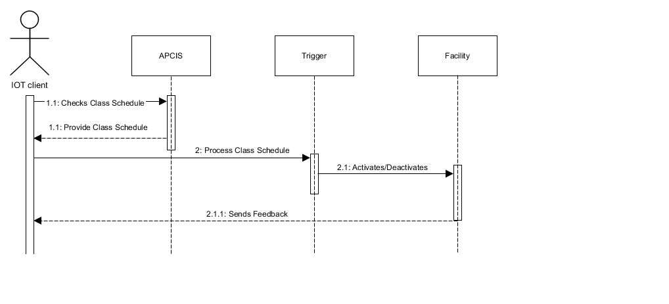
System Sequence Diagram Operations

Slide 54
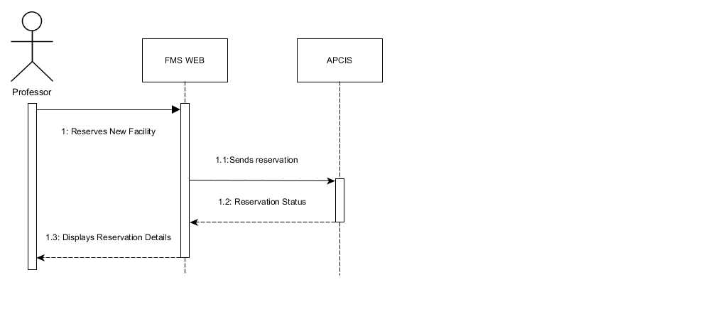
System Sequence Diagram Reservations

Slide 55
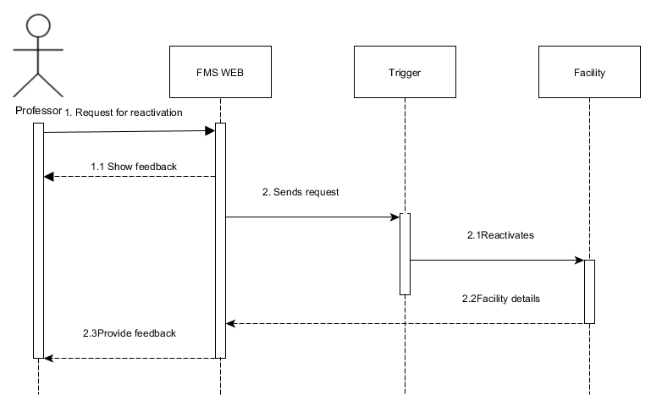
System Sequence Diagram Reactivation

Slide 56
Object Diagram

Slide 57
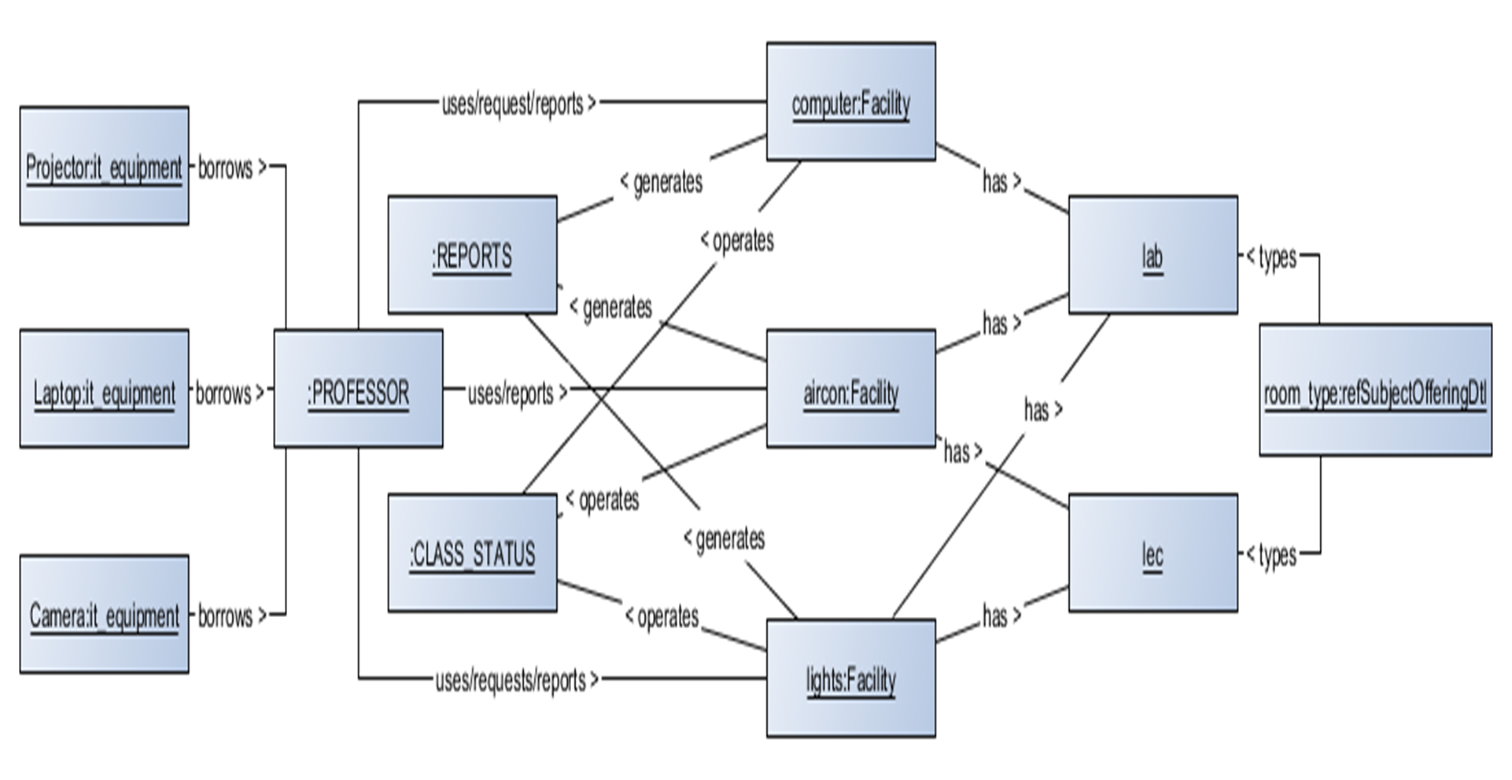
Object Diagram

Slide 58
Class Diagram

Slide 59
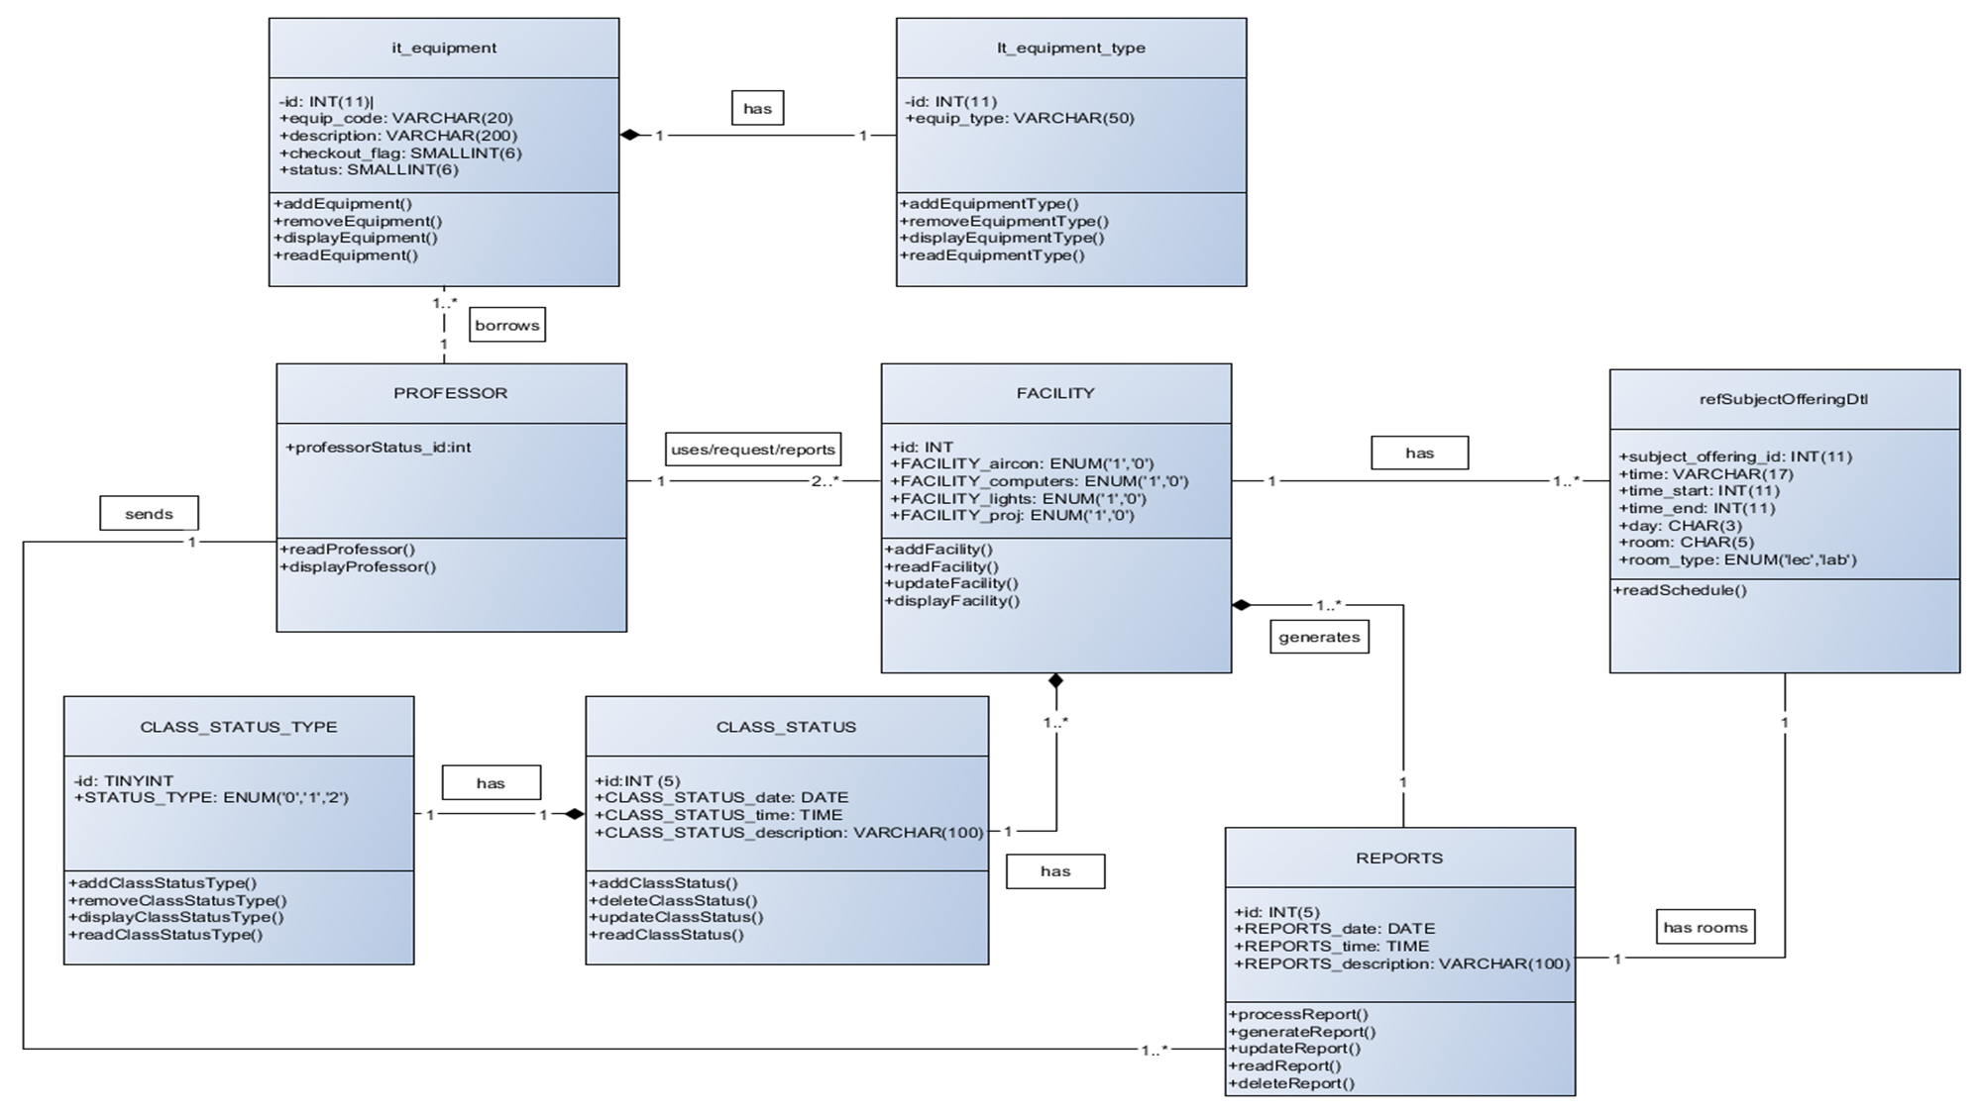
Class Diagram

